Slide 1
HTML TAGS
FOR MEDIA
Video
Audio &
Canvas

Slide 2
<Video>
HTML TAGS
FOR MEDIA
Optional Video Attributes
Poster- An image to act as a holding frame before playback begins.
Preload- How much the video should be buffered.
none: Go steady on the server. Only fetch video data once playback has been invoked.
metadata: Fetch metadata, such as duration and dimensions, and maybe even a cheeky frame or two.
auto: User comes before server — download the whole lot before playback even begins, if necessary.

Slide 3
<Video>
HTML TAGS
FOR MEDIA
Optional Video Attributes
Autoplay- Automatically plays the video upon loading
Loop- Constantly replays the video once it has finished.
Muted- Mutes the video resource by default.
Controls- Instructs the browser to apply its own in-built set of user controls (to stop, play, mute, etc.).

Slide 4
<Video>
HTML TAGS
FOR MEDIA
Optional Video Attributes
Mediagroup- Groups together several video and/or audio elements. Those elements sharing the same mediagroup value become part of the same group.
Width- The width of the video in pixels. This can also be done, or overridden, with CSS.
Height- The height of the video in pixels. This can also be done, or overridden, with CSS.

Slide 5
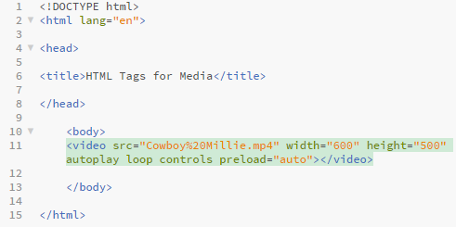
<Video>
HTML TAGS
FOR MEDIA
Example Code

Slide 6
<Audio>
HTML TAGS
FOR MEDIA
Optional Attributes
Same as video optional attributes.
Preload
Autoplay
Loop
Muted
Controls
Mediagroup

Slide 7
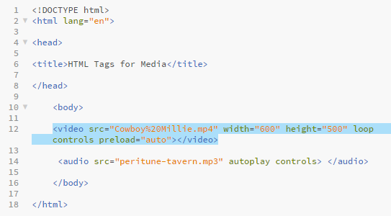
<Audio>
HTML TAGS
FOR MEDIA
Code Example

Slide 8
<Canvas>
HTML TAGS
FOR MEDIA
What is it?
The HTML <canvas> element is used to draw graphics, on the fly, via scripting (usually JavaScript).
The <canvas> element is only a container for graphics. You must use a script to actually draw the graphics.
Canvas has several methods for drawing paths, boxes, circles, text, and adding images.

Slide 9
<Canvas>
HTML TAGS
FOR MEDIA
What is it?
HTML Canvas Can Draw Text
Canvas can draw colorful text, with or without animation.
HTML Canvas Can Draw Graphics
Canvas has great features for graphical data presentation with an imagery of graphs and charts.
HTML Canvas Can be Animated
Canvas objects can move. Everything is possible: from simple bouncing balls to complex animations.
HTML Canvas Can be Interactive
Canvas can respond to JavaScript events.

Slide 10
<Canvas>
HTML TAGS
FOR MEDIA
What is it?
Canvas can respond to any user action (key clicks, mouse clicks, button clicks, finger movement).
HTML Canvas Can be Used in Games
Canvas' methods for animations, offer a lot of possibilities for HTML gaming applications.

Slide 11
<Canvas>
HTML TAGS
FOR MEDIA
Getting Set Up
<canvas> is just like any other tag. It has an opening and a closing element and needs to be assigned an id.
You can assign a width and height, otherwise it just defaults to 300 pixels wide and 150 pixels high.
To display something, a script first needs to access the rendering context and draw on it. The <canvas> element has a method called getContext(), used to obtain the rendering context and its drawing functions. getContext() takes one parameter, the type of context. For 2D graphics, you specify "2d“.

Slide 12
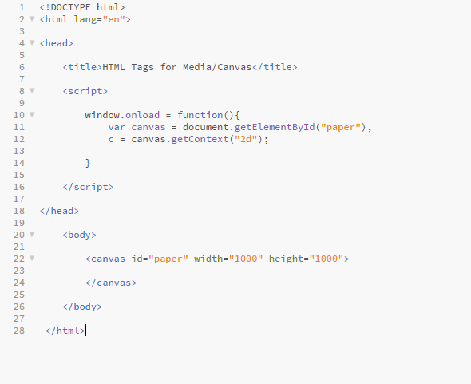
<Canvas>
HTML TAGS
FOR MEDIA
Example Code

Slide 13

<Canvas>
HTML TAGS
FOR MEDIA
Example Code
In order to make the canvas visible to you, you might want to add a border or fill it. In my case I colored the entire canvas black.
The values inputted into the rec() in order are:
The x-coordinate of the upper-left corner of the rectangle, The y-coordinate of the upper-left corner of the rectangle, The width of the rectangle, in pixels, The height of the rectangle, in pixels.

Slide 14
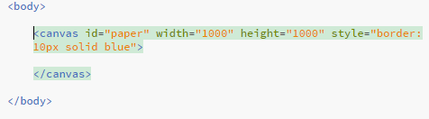
<Canvas>
HTML TAGS
FOR MEDIA
Example Code
You could also use the border attribute in your HTML <canvas> tag to create a border.

Slide 15
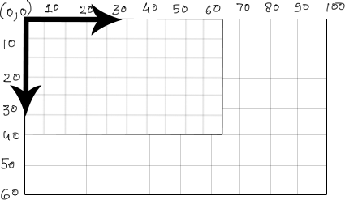
<Canvas>
HTML TAGS
FOR MEDIA
Canvas Coordinates
In canvas the coordinates are a little different than we are used to, instead of X=0 Y=0 being the center, it would give us the upper left hand corner as shown in the illustration.
x
x
y
Take note that the Y is positive going downward.

Slide 16
<Canvas>
HTML TAGS
FOR MEDIA
Creating Text
Choose a font style
Choose a fillStyle or a strokeStyle
Choose fillText or strokeText
*Show examples
y

Slide 17

<Canvas>
HTML TAGS
FOR MEDIA
Drawing Shapes
Similar to the way we filled our canvas we can create a rectangle, just set the coordinate to something other than 0,0. You can make it hollow with strokeSyle or filled in with fillStyle.
y

Slide 18

<Canvas>
HTML TAGS
FOR MEDIA
Drawing Shapes
Just like with the rectangle, the first two values are the x, and y coordinates.
y

Slide 19
Resources
HTML TAGS
FOR MEDIA
http://www.htmldog.com/guides/html/advanced/embeddedcontent/
Great rundown of the three tags we discussed. Good quick refresher if you aren’t feeling too confident.
http://htmldog.com/references/html/tags/audio/
Everything you need to know about the <audio> tag.
y

Slide 20
Resources
HTML TAGS
FOR MEDIA
http://htmldog.com/references/html/tags/video/
Of course something about the <video> tag.
https://developer.mozilla.org/en-US/docs/Web/API/Canvas_API/Tutorial/Basic_usage
This tutorial for <canvas> is AMAZING, be sure to click all of the different ones found in the left-hand sidebar.
y

Slide 21
Resources
HTML TAGS
FOR MEDIA
https://www.youtube.com/watch?v=N0BNbngr2IY&t=604s
This is a good video that just goes over the basics of <canvas>
https://www.html5canvastutorials.com/
https://www.liberiangeek.net/2017/01/8-cool-effects-you-can-create-with-html5-canvas/
More advanced <canvas> projects. I like these sites because all of the projects link to codepen where you can view and edit the code.
y

